Slide 1
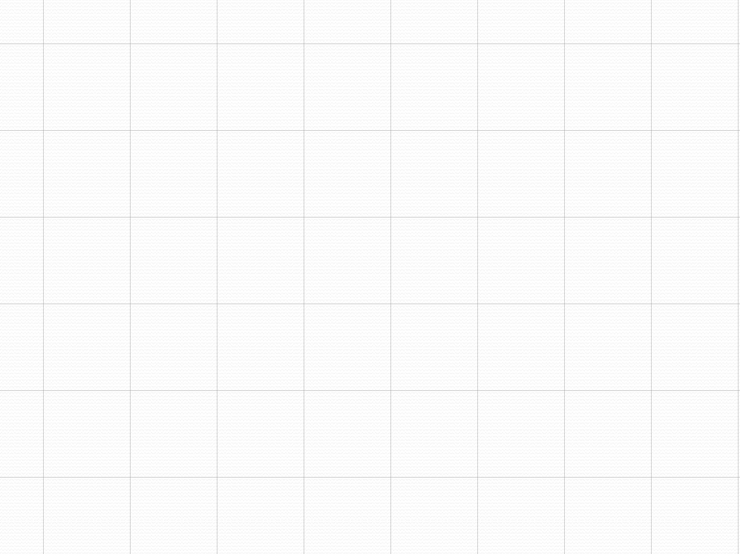
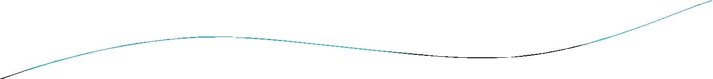


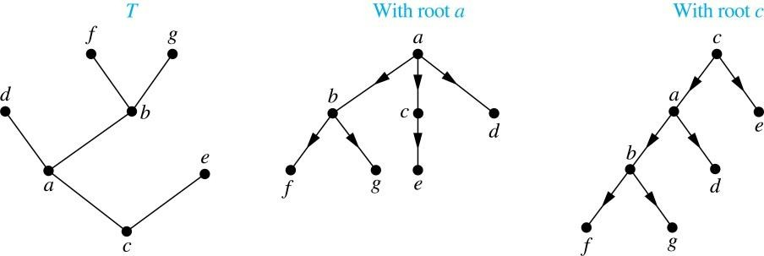
Rooted Trees
Definition: A rooted tree is a tree in which one vertex has been designated as the root and every edge is directed away from the root.
An unrooted tree is converted into different rooted trees
when different vertices are chosen as the root.

Slide 2
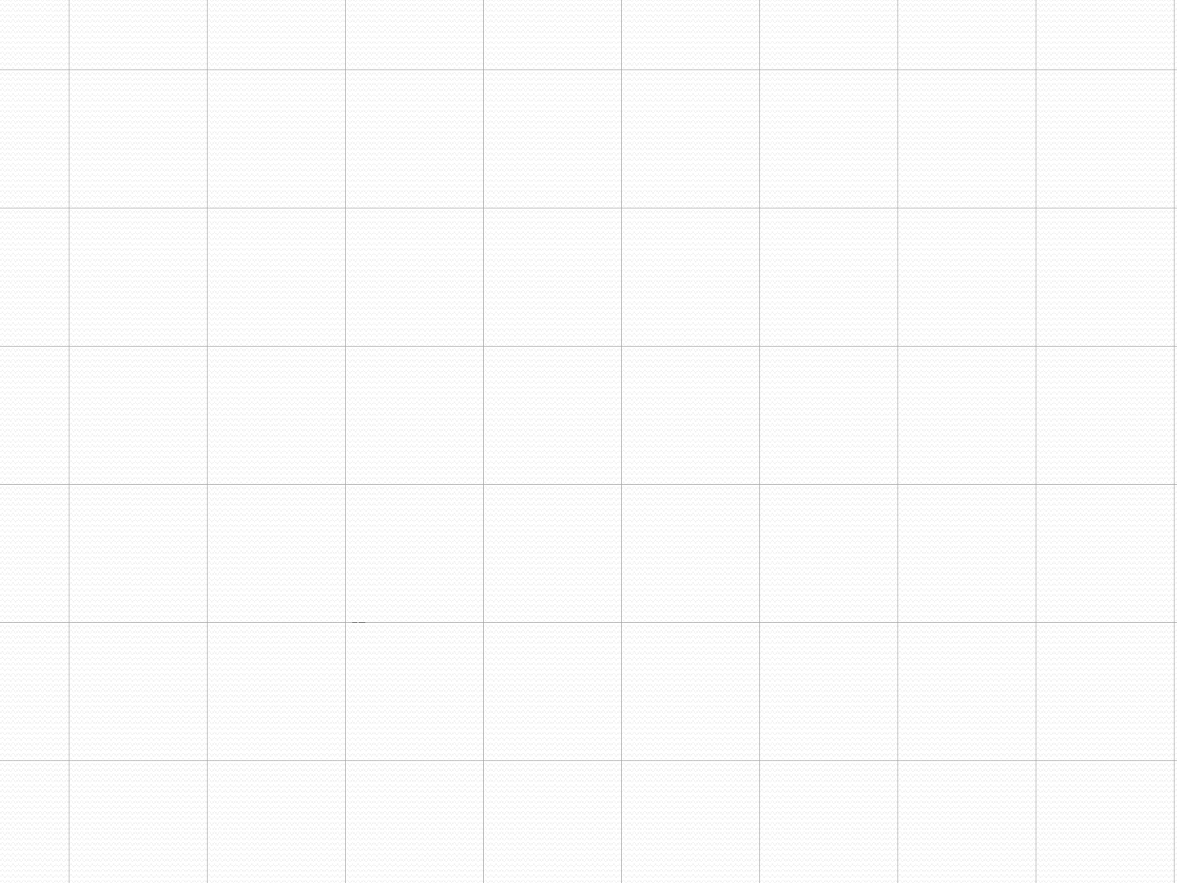
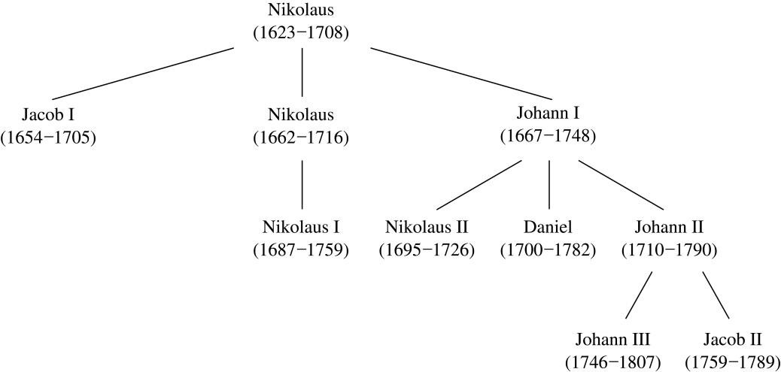
Rooted Tree Terminology
Terminology for rooted trees is a mix from botany and genealogy (such as this family tree of the Bernoulli family of mathematicians).

Slide 3
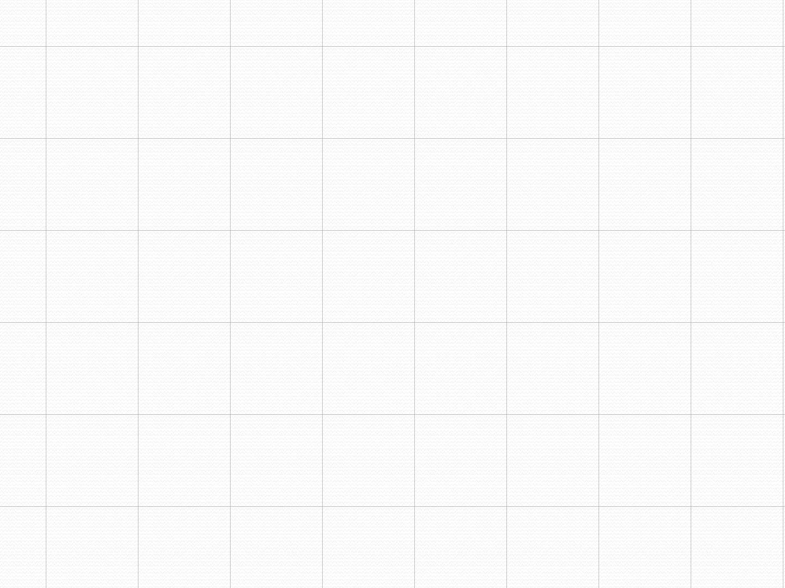
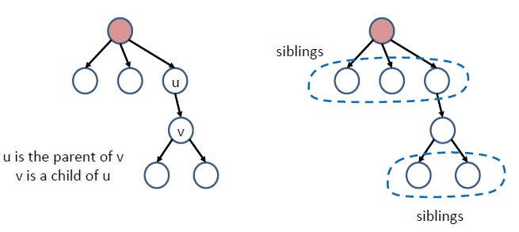
Rooted Tree Terminology
If v is a vertex of a rooted tree other than the root, the parent of v is the unique vertex u such that there is a directed edge from u to v. When u is a parent of v, v is called a child of u. Vertices with the same parent are called siblings.

Slide 4
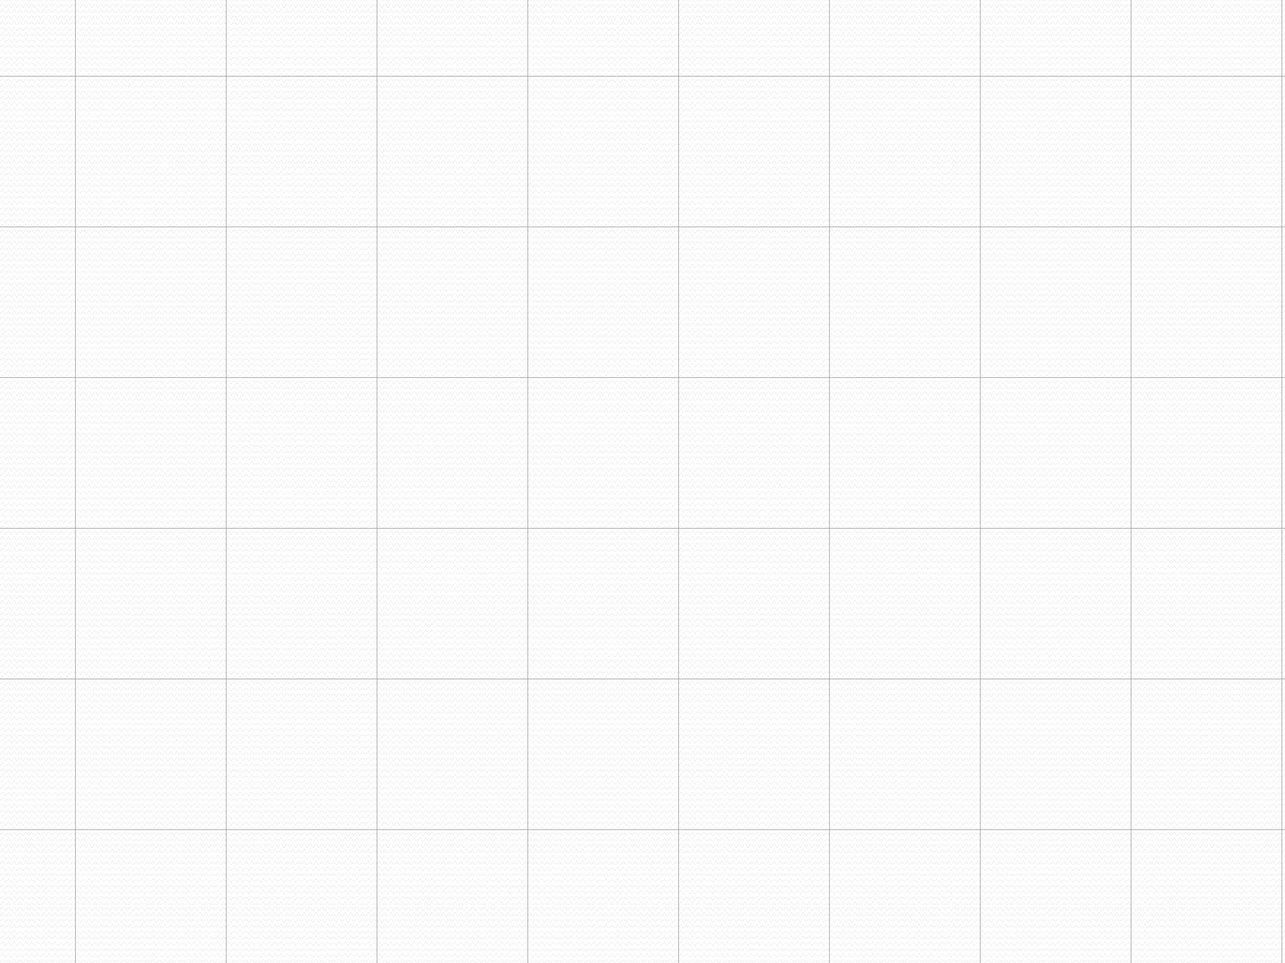
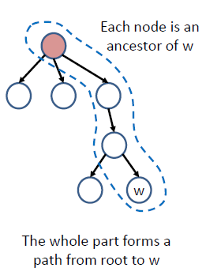
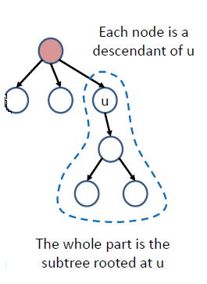
Rooted Tree Terminology
The ancestors of a vertex are the vertices in the path from the root to this vertex, excluding the vertex itself and including the root.
The descendants of a vertex v are those vertices that have v as an ancestor. The subtree rooted at u includes all the descendants of u, and all edges that connect between them.

Slide 5
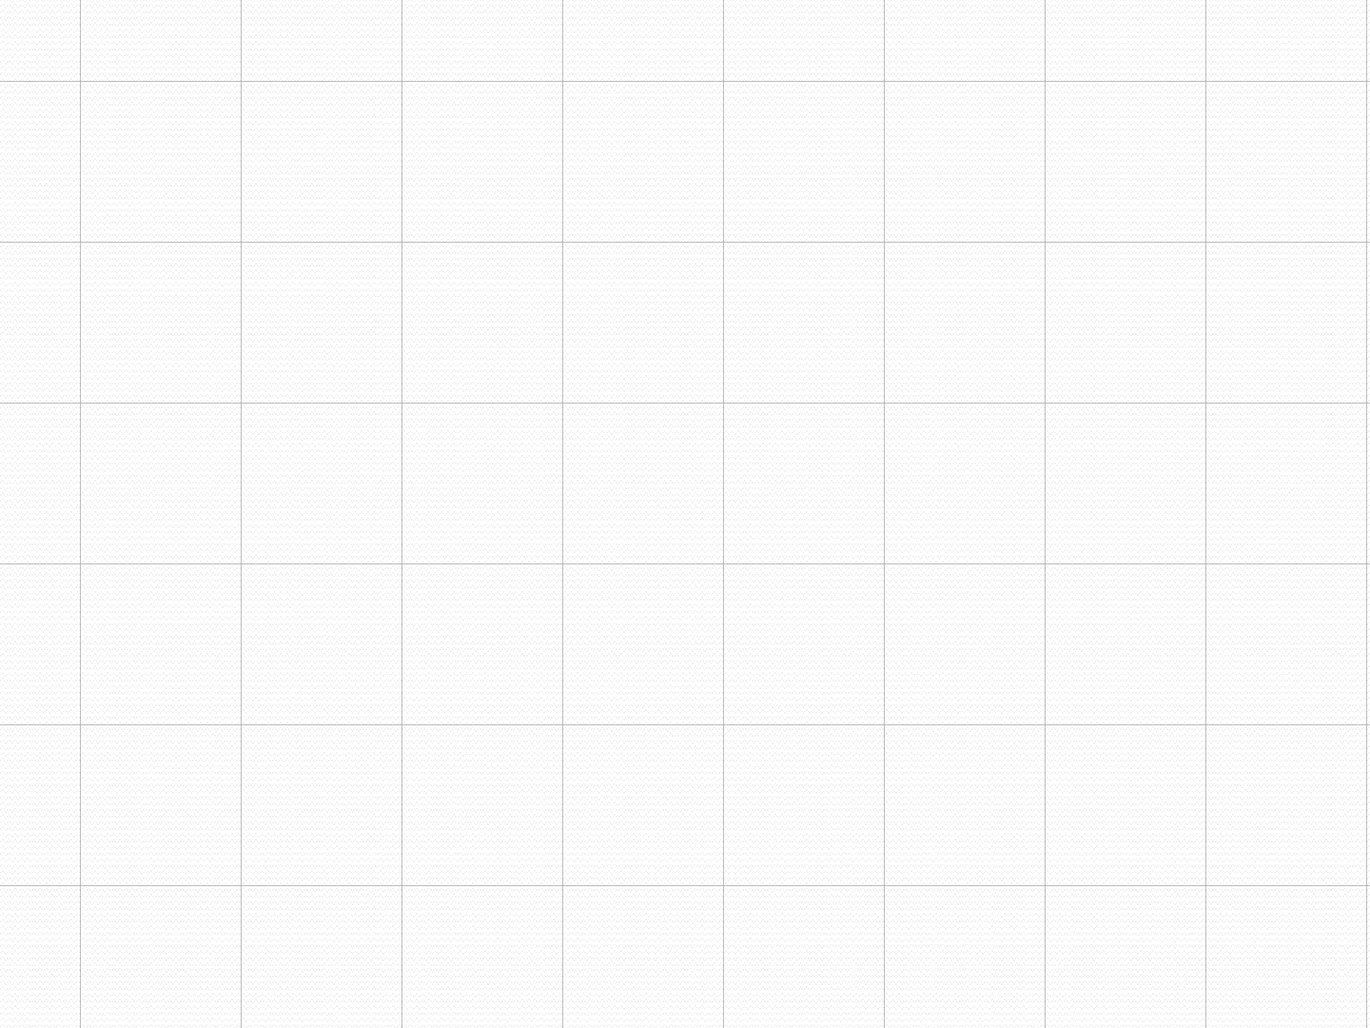
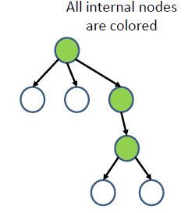
Rooted Tree Terminology
A vertex of a rooted tree with no children is called a leaf. Vertices that have children are called internal vertices.

Slide 6
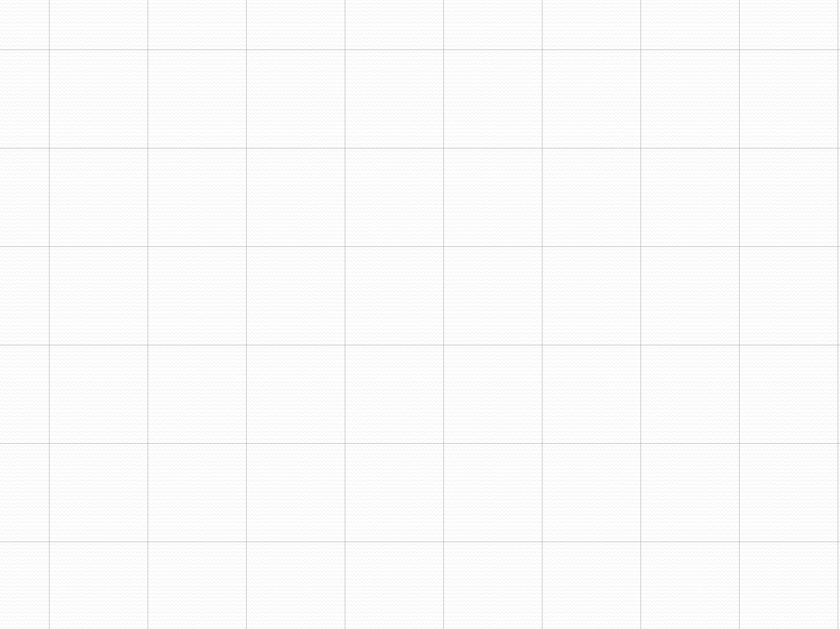
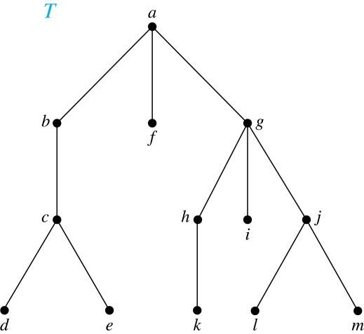
Terminology for Rooted Trees
Example: In the rooted tree T
(with root a):
(i) Find the parent of c, the children of g, the siblings of h, the ancestors of e, and the descendants of b.
Solution:
(i) The parent of c is b. The children of g are h, i, and j. The siblings of h are i and j. The ancestors of e are c, b, and a. The descendants of b are c, d, and e.

Slide 7
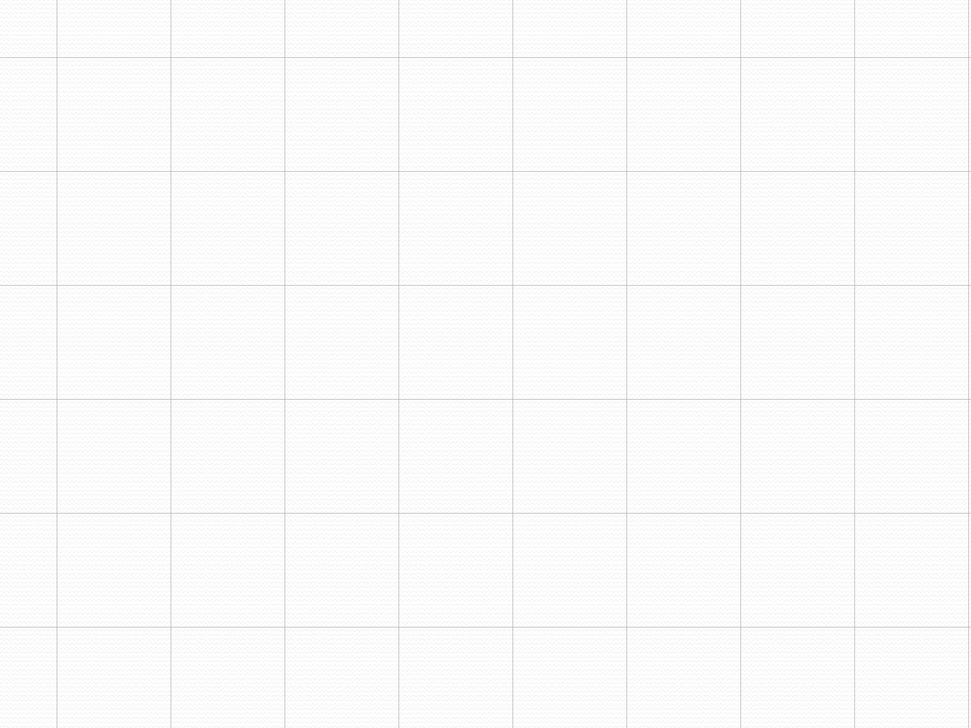
Terminology for Rooted Trees
Example: In the rooted tree T (with root a):
(i) Find all internal
vertices and all leaves.
Solution:
(i) The internal vertices are a, b, c, g, h, and j. The leaves are d, e, f, i, k, l, and m.

Slide 8
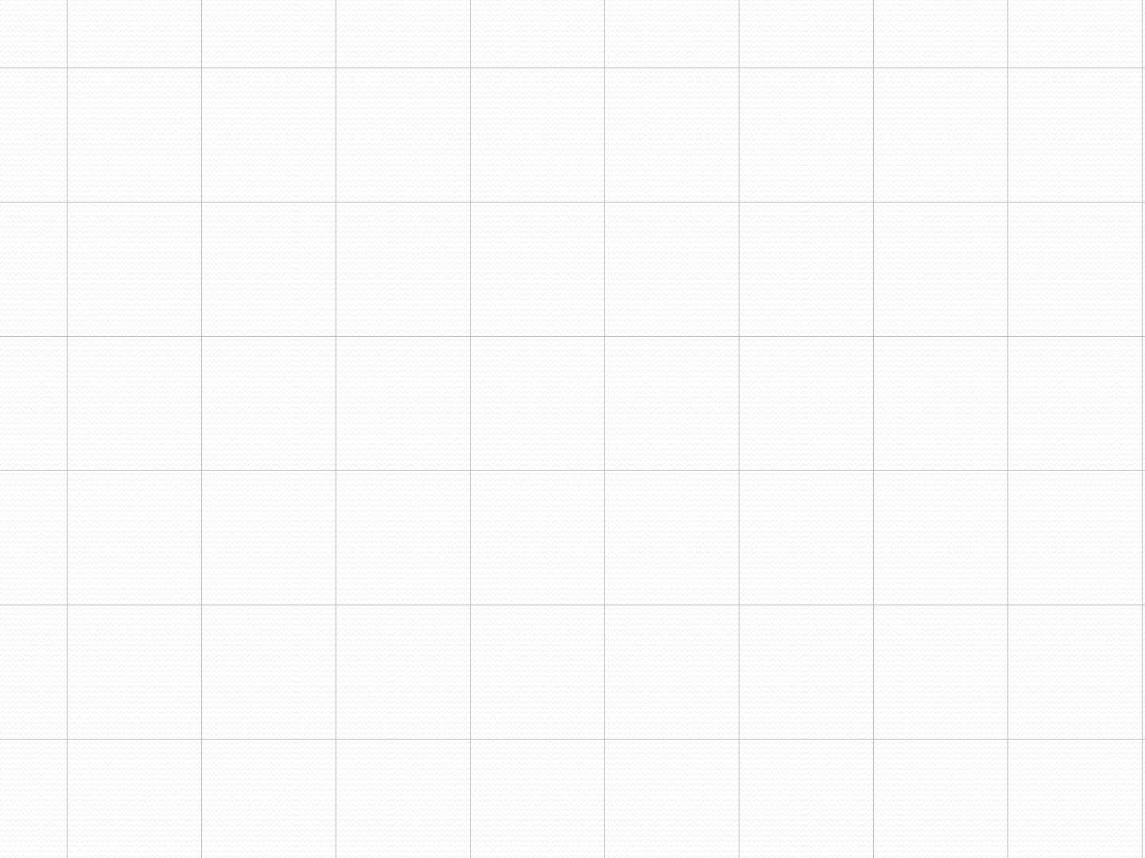
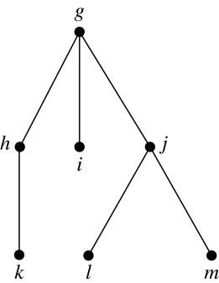
Terminology for Rooted Trees
(i) What is the subtree rooted at g?
Solution:
(i) We display the subtree
rooted at g.

Slide 9
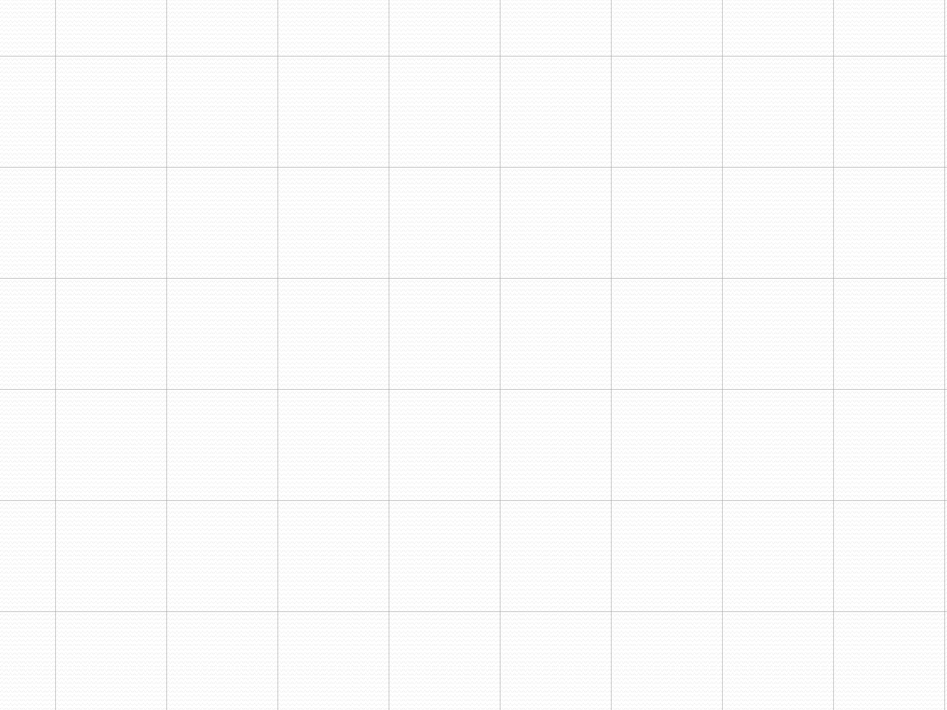
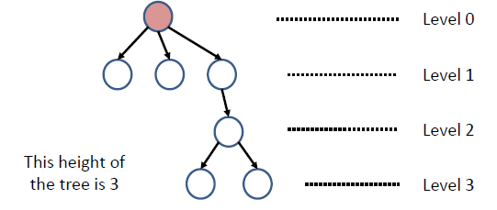
Level of vertices and height of trees
When working with trees, we often want to have rooted trees where the sub trees at each vertex contain paths of approximately the same length.
To make this idea precise we need some definitions:
The level of a vertex v in a rooted tree is the length of the
unique path from the root to this vertex.
The height of a rooted tree is the maximum of the levels of the vertices.

Slide 10
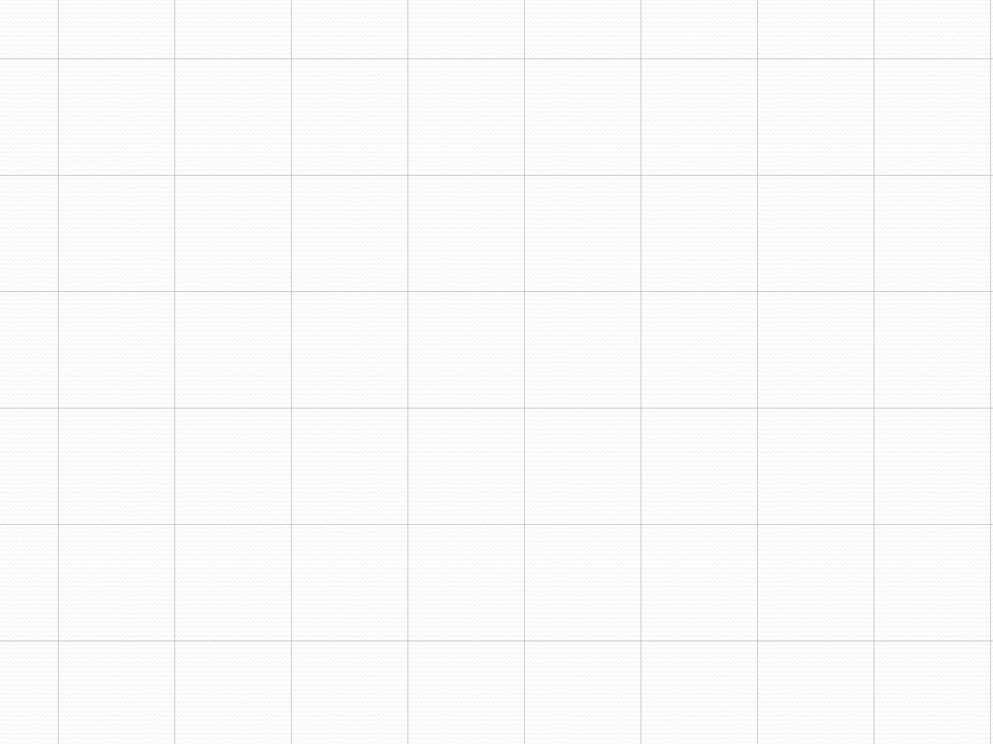
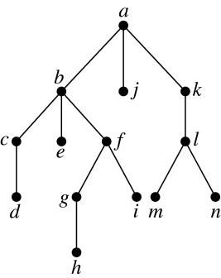
Level of vertices and height of trees
Example:
Find the level of each vertex in the tree to the right.
What is the height of the tree?
Solution:
i) The root a is at level 0. Vertices b, j, and k are at level 1.
Vertices c, e, f, and l are at level 2.
Vertices d, g, i, m, and n are at level 3. Vertex h is at level 4.
The height is 4, since 4 is the largest level of any vertex.

Slide 11
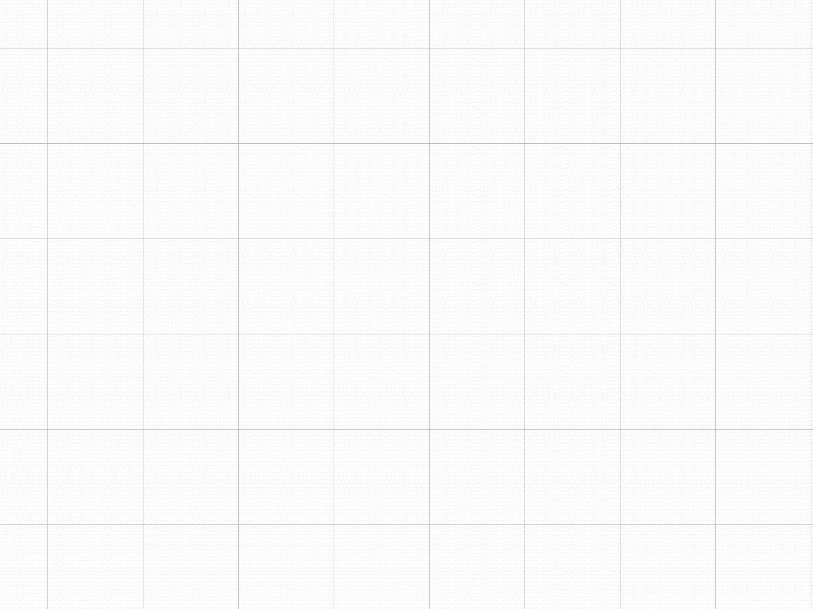
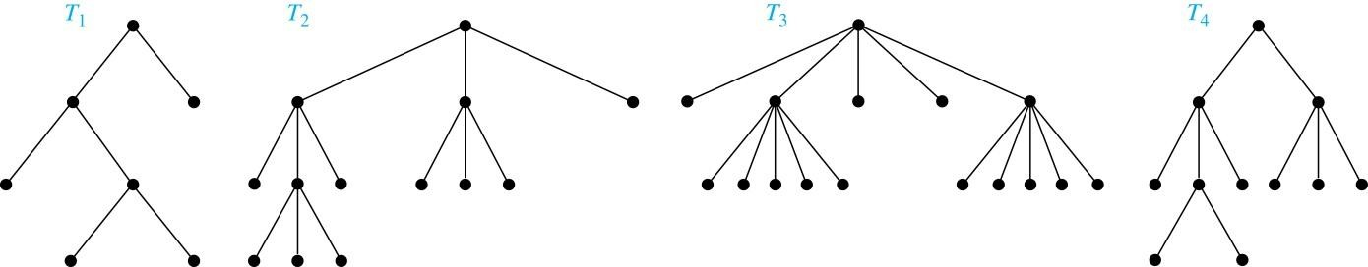
m-ary Rooted Trees
Definition: A rooted tree is called an m-ary tree if every internal vertex has no more than m children. The tree is called a full m-ary tree if every internal vertex has exactly m children. An m-ary tree with m = 2 is called a binary tree.
Example: Are the following rooted trees full m-ary trees for some positive integer m?

Slide 12
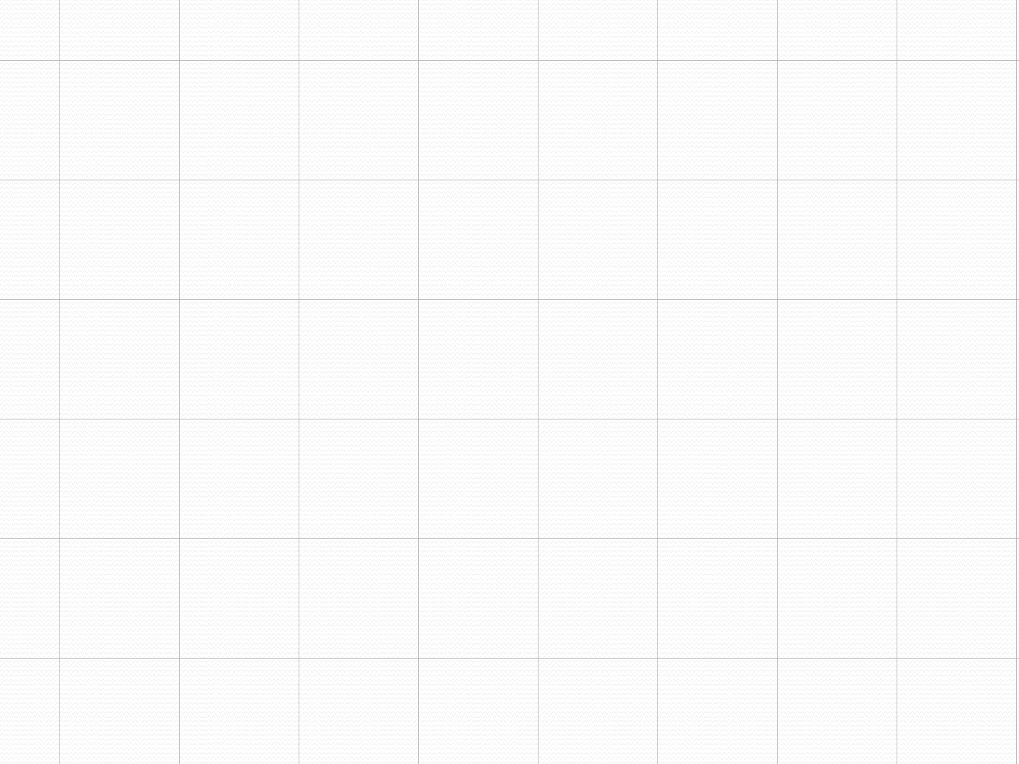
Solution:
⚫
T₁ is a full binary tree because each of its internal
vertices has two children.
T₂ is a full 3-ary tree because each of its internal vertices has three children.
In T3 each internal vertex has five children, so T3 is a
full 5-ary tree.
T4 is not a full m-ary tree for any m because some of its internal vertices have two children and others have three children.

Slide 13
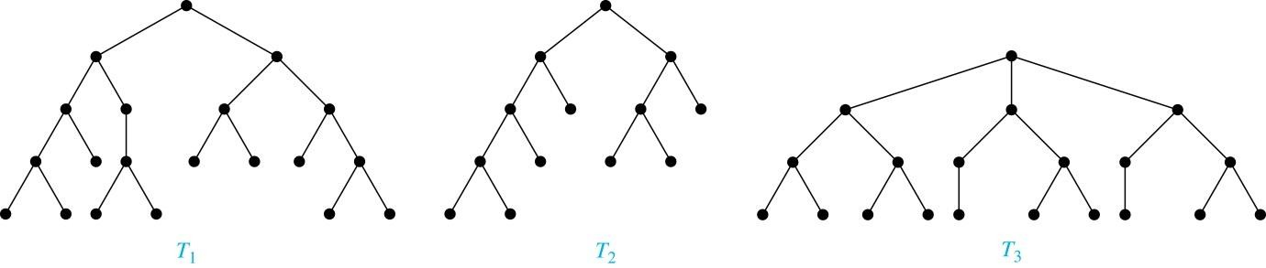
Balanced m-Ary Trees
Definition: A rooted m-ary tree of height h is balanced if
all leaves are at levels h or h − 1.
Example: Which of the rooted trees shown below is balanced?
Solution: T₁ and T₃ are balanced, but T₂ is not because it has leaves at levels 2, 3, and 4.

Slide 14
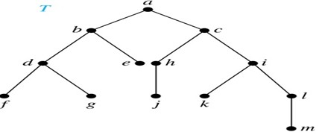
Ordered Rooted Trees
Definition: An ordered rooted tree is a rooted tree where the children of each internal vertex are ordered.
We draw ordered rooted trees so that the children of each internal
vertex are shown in order from left to right.

Slide 15
Binary Trees
Definition: A binary tree is an ordered rooted where each internal vertex has at most two children. If an internal vertex of a binary tree has two children, the first is called the left child and the second the right child. The tree rooted at the left child of a vertex is called the left subtree of this vertex, and the tree rooted at the right child of a vertex is called the right subtree of this vertex.

Slide 16
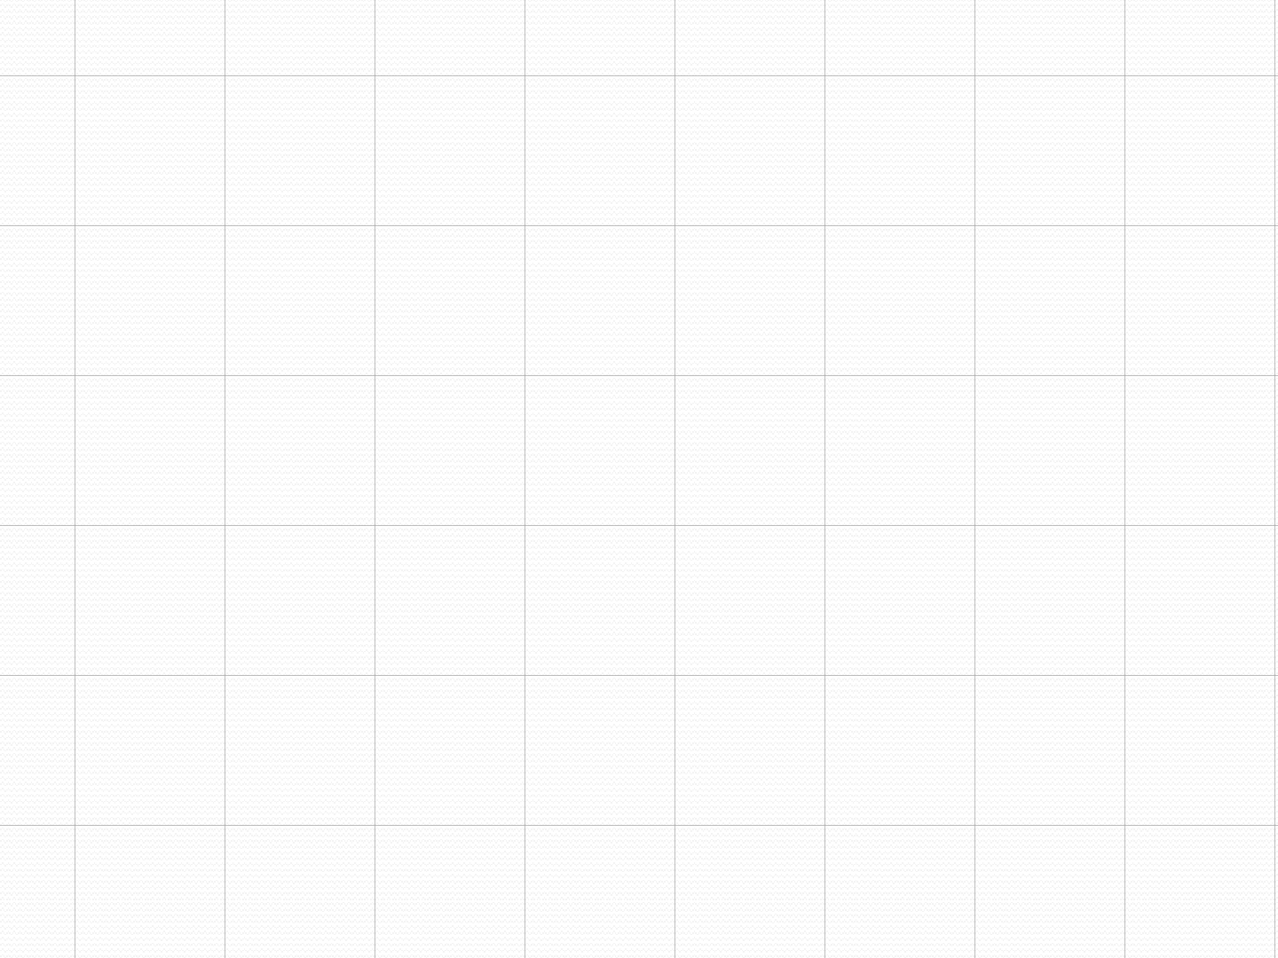
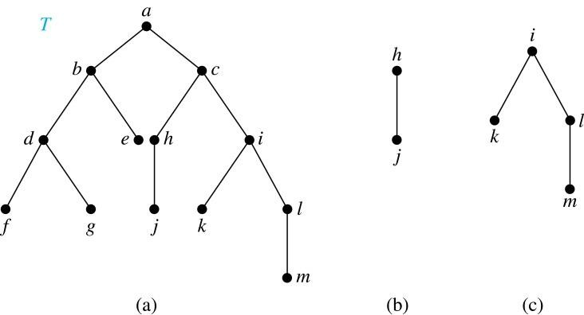
Example:
Consider the binary tree T.
What are the left and right children of d?
What are the left and right sub trees of c?
Solution:
The left child of d is f and the right child is g.
The left and right subtrees of c are displayed in (b) and (c).

Slide 17
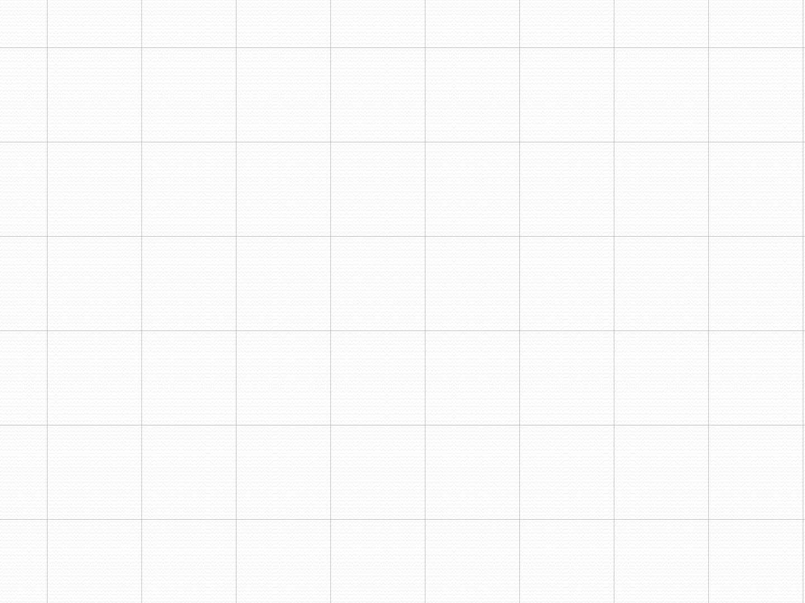
Binary Search Tree
Definition: A binary tree in which the vertices are labeled with items so that a label of a vertex is greater than the labels of all vertices in the left subtree of this vertex and is less than the labels of all vertices in the right subtree of this vertex.
Searching for items in a list is one of the most important tasks that arises in computer science.
Our primary goal is to implement a searching algorithm that finds items efficiently when the items are totally ordered. This can be accomplished through the use of a binary search tree.

Slide 18
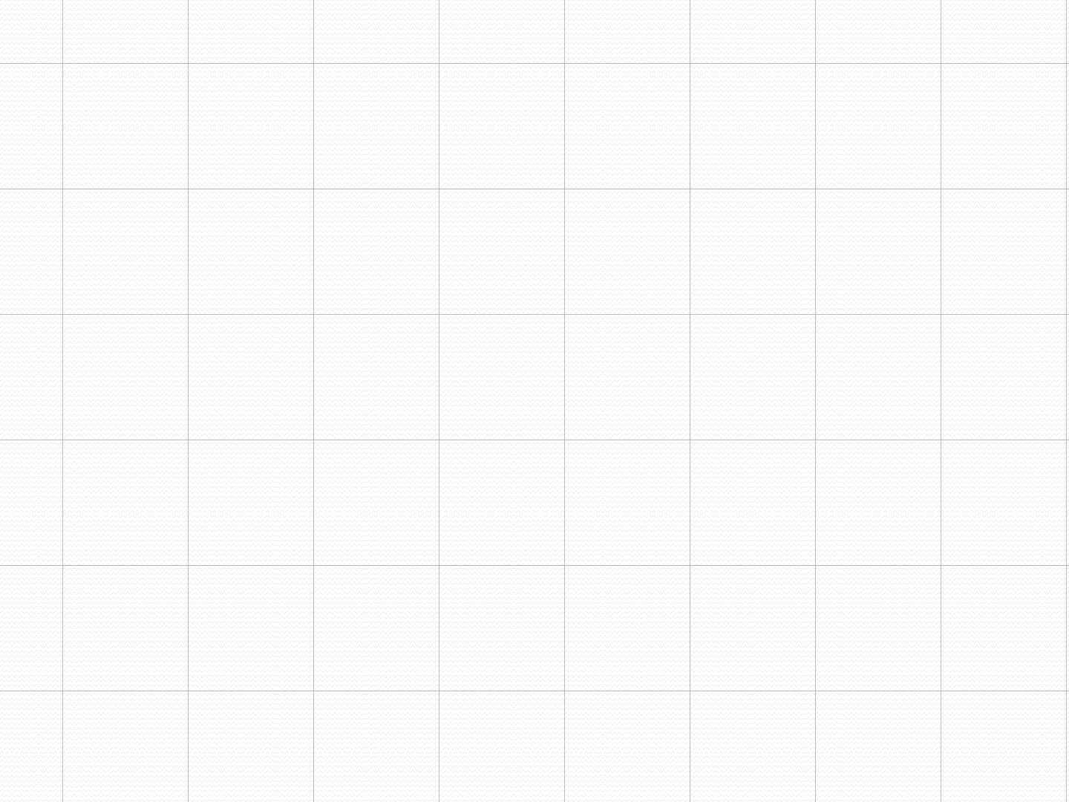
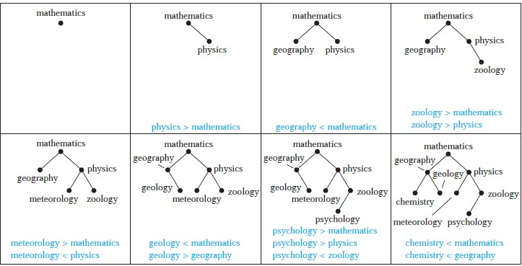
Example : Form a binary search tree for the words mathematics, physics, geography, zoology, meteorology, geology, psychology, and chemistry (using alphabetical order).

Slide 19

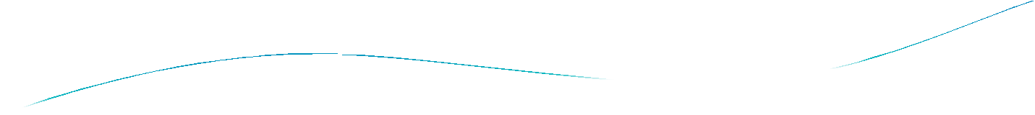

Section 11.3

Slide 20
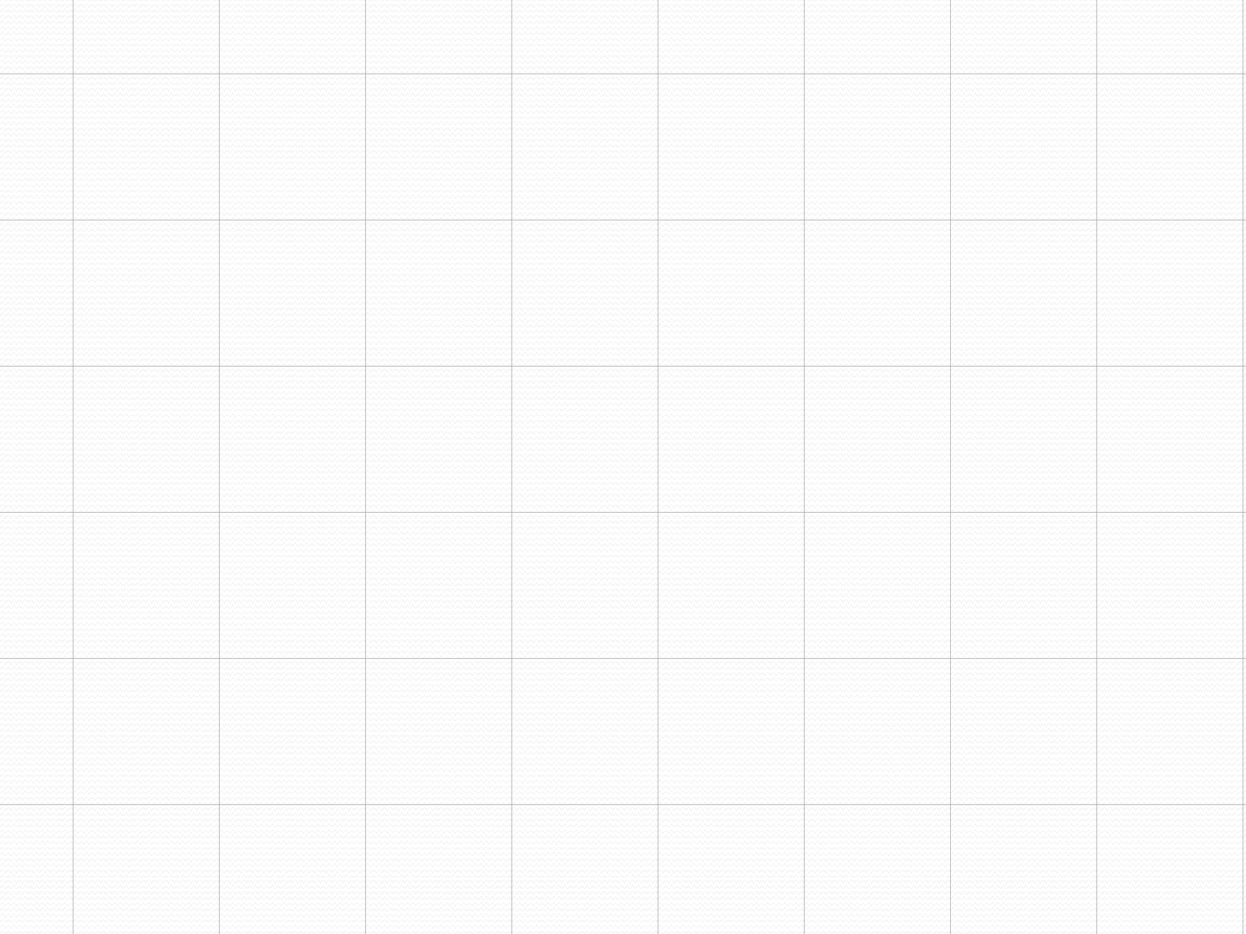
Tree Traversal
Procedures for systematically visiting every vertex of an ordered tree are called traversals.
The three most commonly used traversals are preorder traversal, inorder traversal, and postorder traversal.

Slide 21
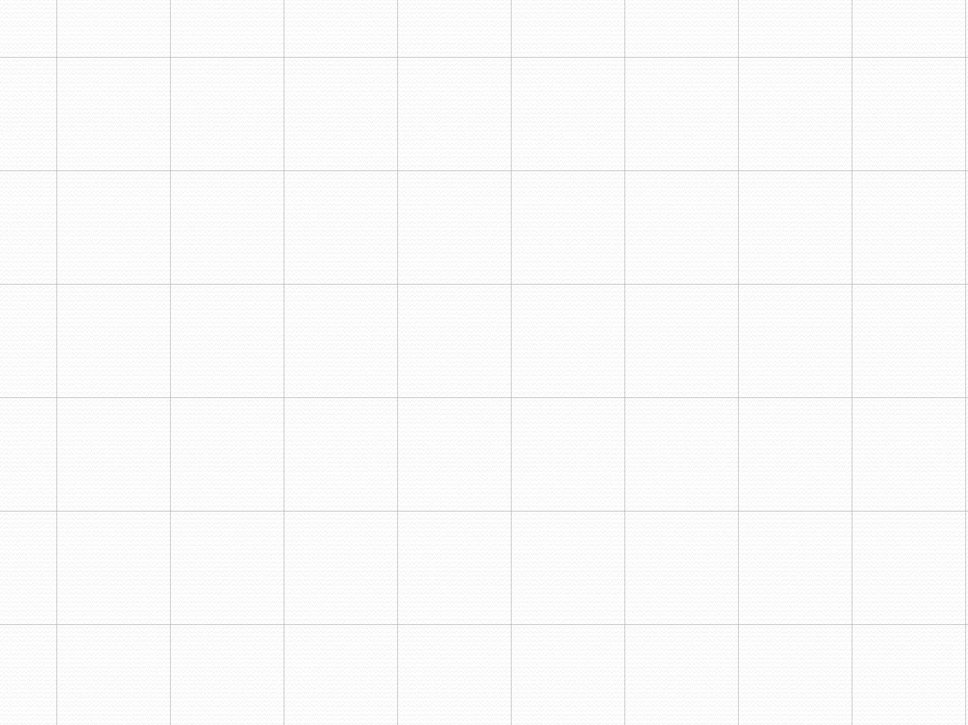
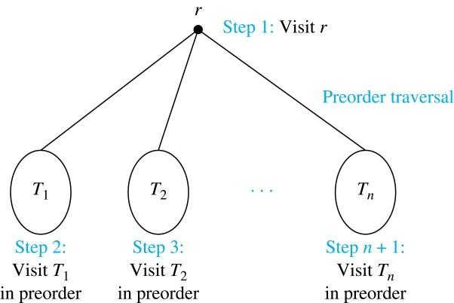
Preorder Traversal(Result in Prefix Exp)
Definition: Let T be an ordered rooted tree with root r. If T consists only of r, then r is the preorder traversal of T. Otherwise, suppose that T₁, T₂, …, T_{n} are the subtrees of r from left to right in T. The preorder traversal begins by visiting r, and continues by traversing T₁ in preorder, then T₂ in preorder, and so on, until T_{n} is traversed in preorder.

Slide 22
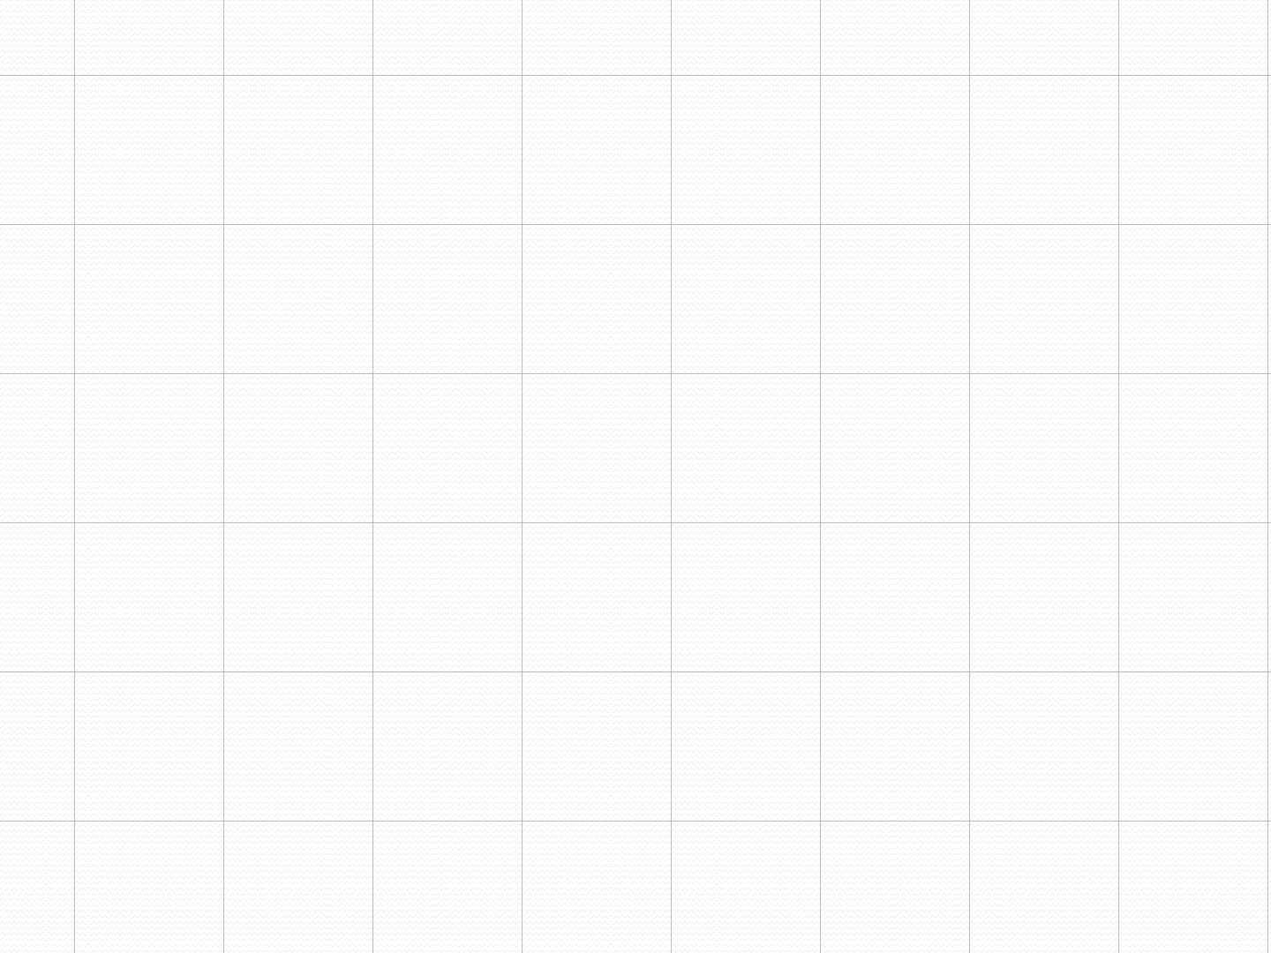
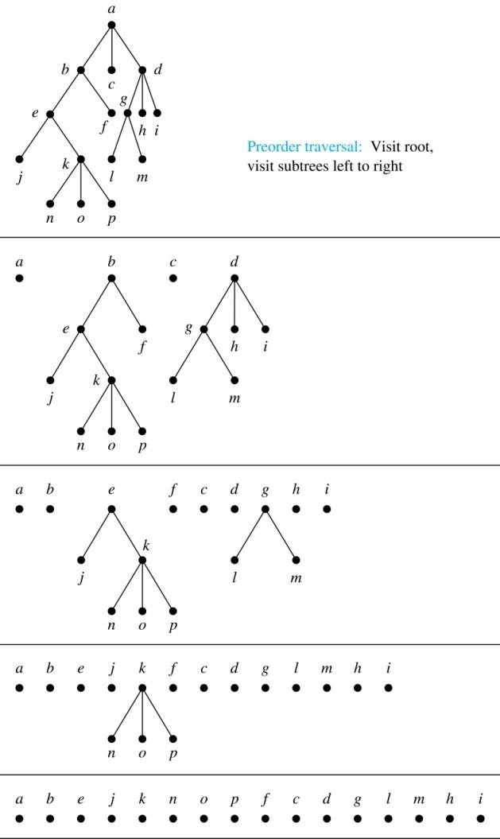
Preorder Traversal (continued)
procedure preorder (T: ordered rooted tree)
r := root of T
list r
for each child c of r
from left to right
T(c) := subtree with
c as root
preorder(T(c))

Slide 23
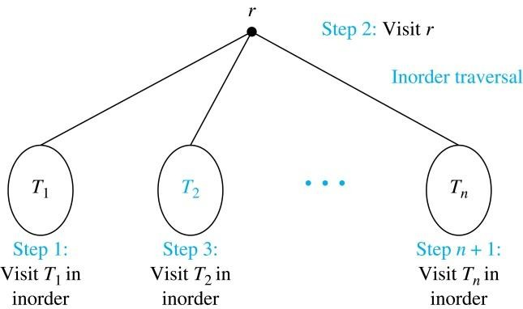
Inorder Traversal (Results in Infix
Definition: Let T be an ordered rooted tree with root r. If T consists only of r, then r is the inorder traversal of T. Otherwise, suppose that T₁, T₂, …, T_{n} are the subtrees of r from left to right in T. The inorder traversal begins by traversing T₁ in inorder, then visiting r, and continues by traversing T₂ in inorder, and so on, until T_{n} is traversed in inorder.

Slide 24
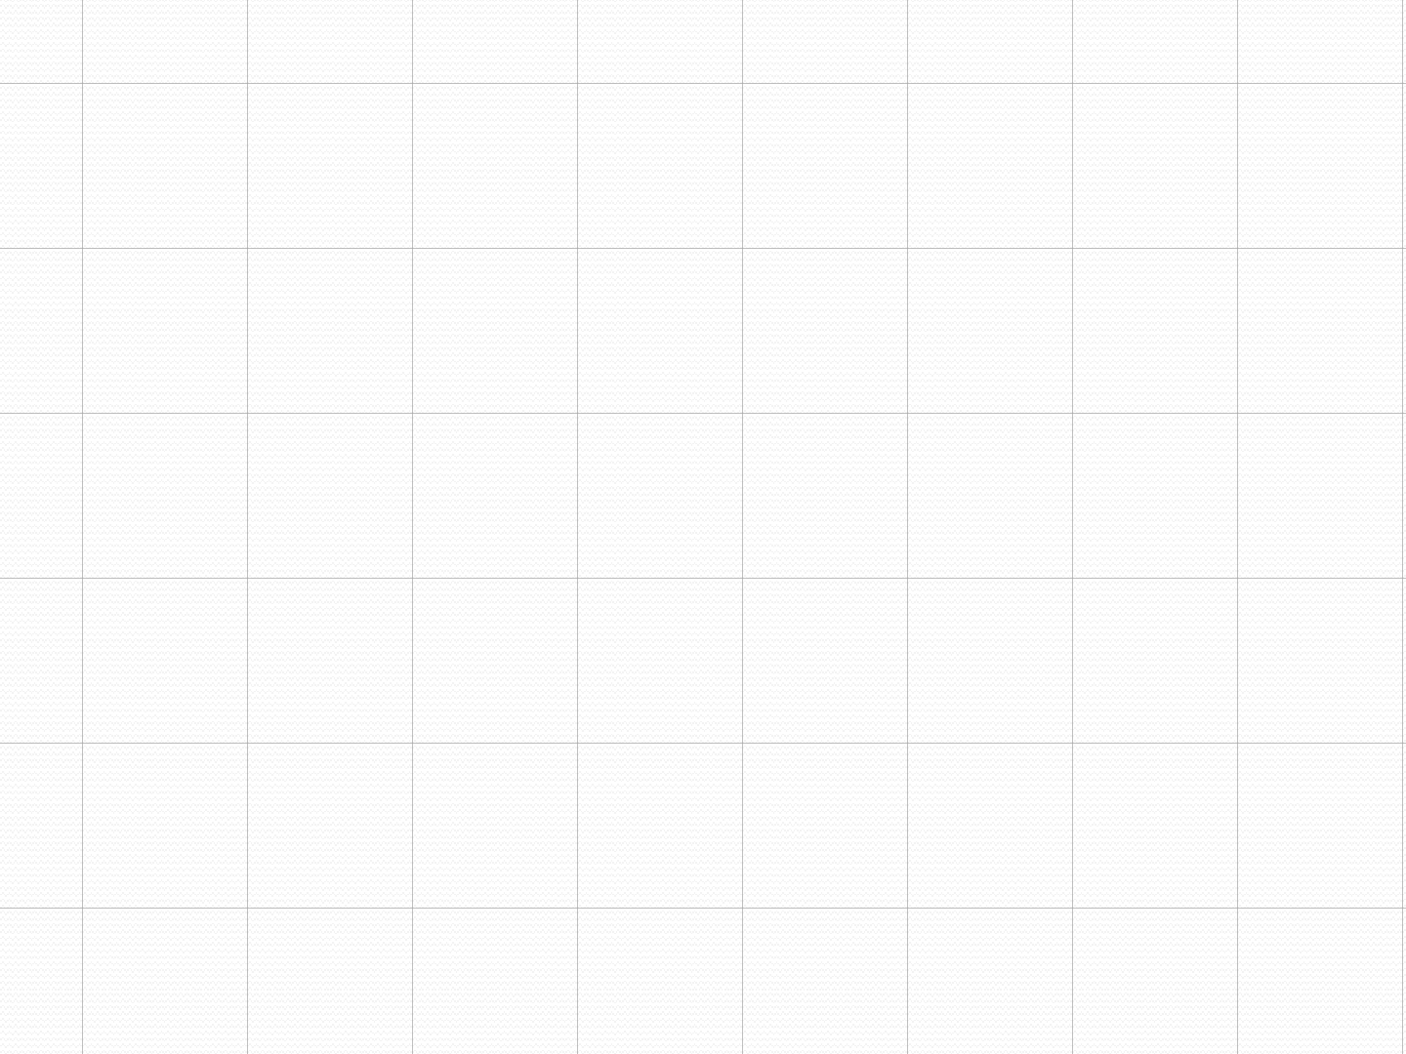
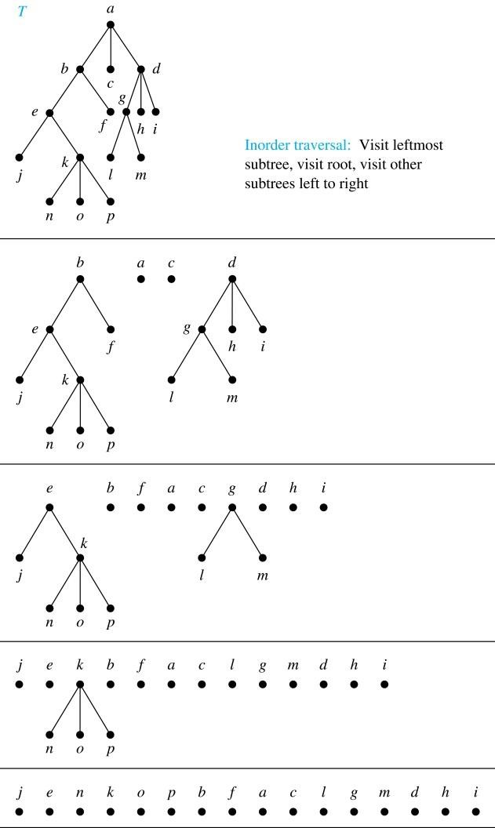
Inorder Traversal (continued)
procedure
inorder (T: ordered rooted tree)
r := root of T
if r is a leaf then list r
else
l := first child of r
from left to right
T(l) := subtree with l
as its root inorder(T(l)) list(r)
for each child c of r
from left to right
T(c) := subtree
with c as root
inorder(T(c))

Slide 25
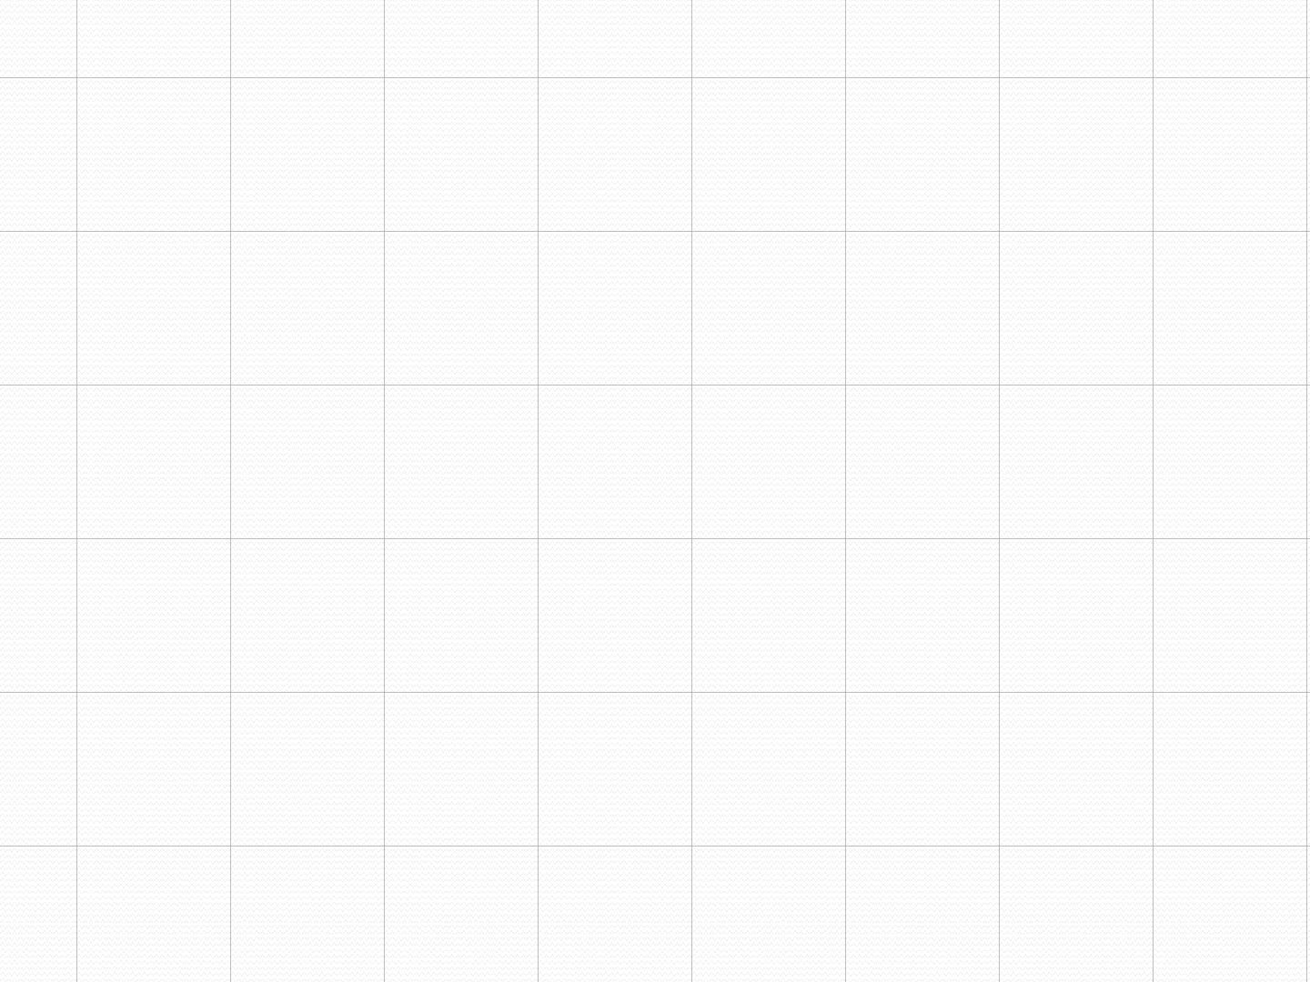
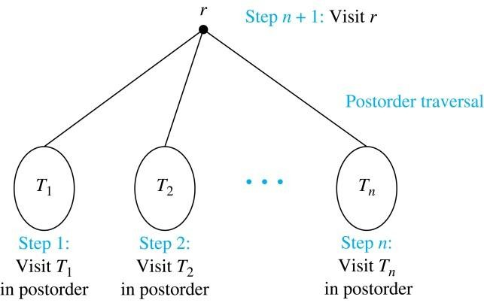
Postorder Traversal (Results in Postfix
Definition: Let T be an ordered rooted tree with root r. If T consists only of r, then r is the postorder traversal of T. Otherwise, suppose that T₁, T₂, …, T_{n} are the subtrees of r from left to right in T. The postorder traversal begins by traversing T₁ in postorder, then T₂ in postorder, and so on, after T_{n} is traversed in postorder, r is visited.

Slide 26
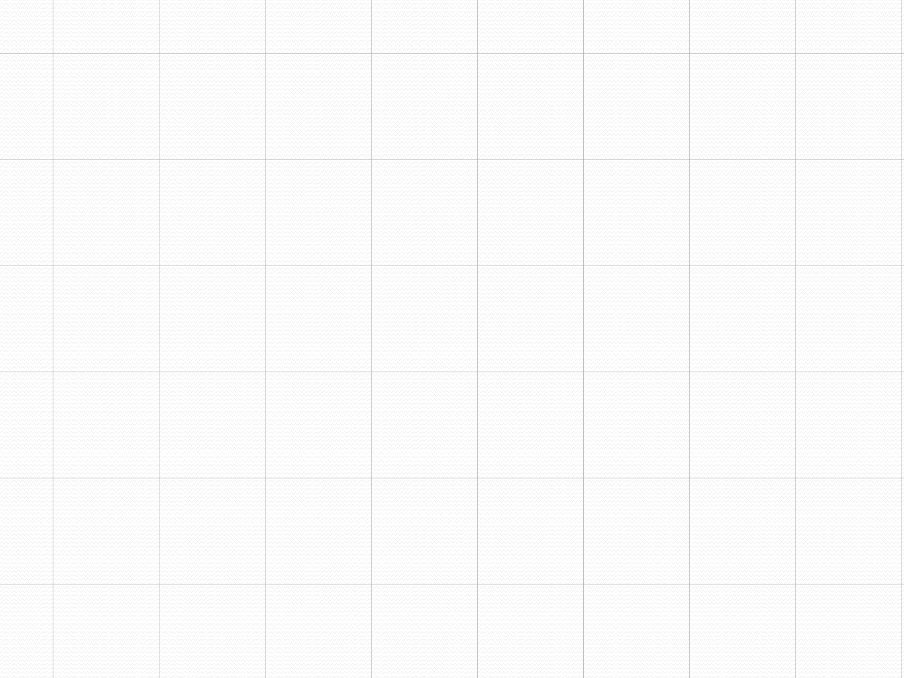
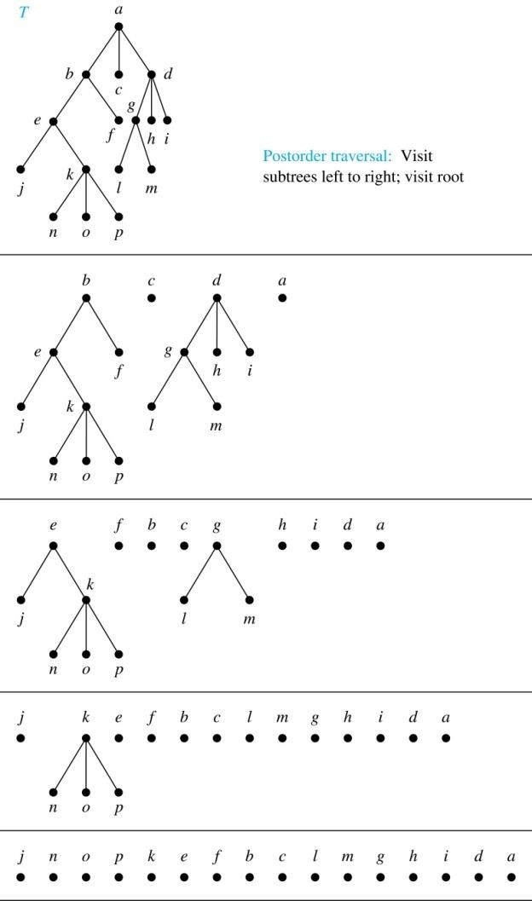
Post order Traversal (continued)
procedure postordered (T: ordered rooted tree)
r := root of T
for each child c of r from left to right T(c) := subtree
with c as root postorder(T(c))
list r

Slide 27



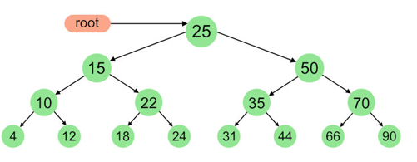

Slide 28
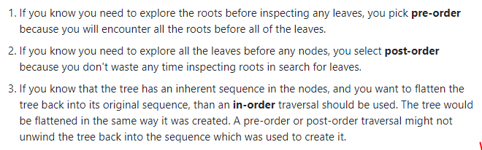

Slide 29
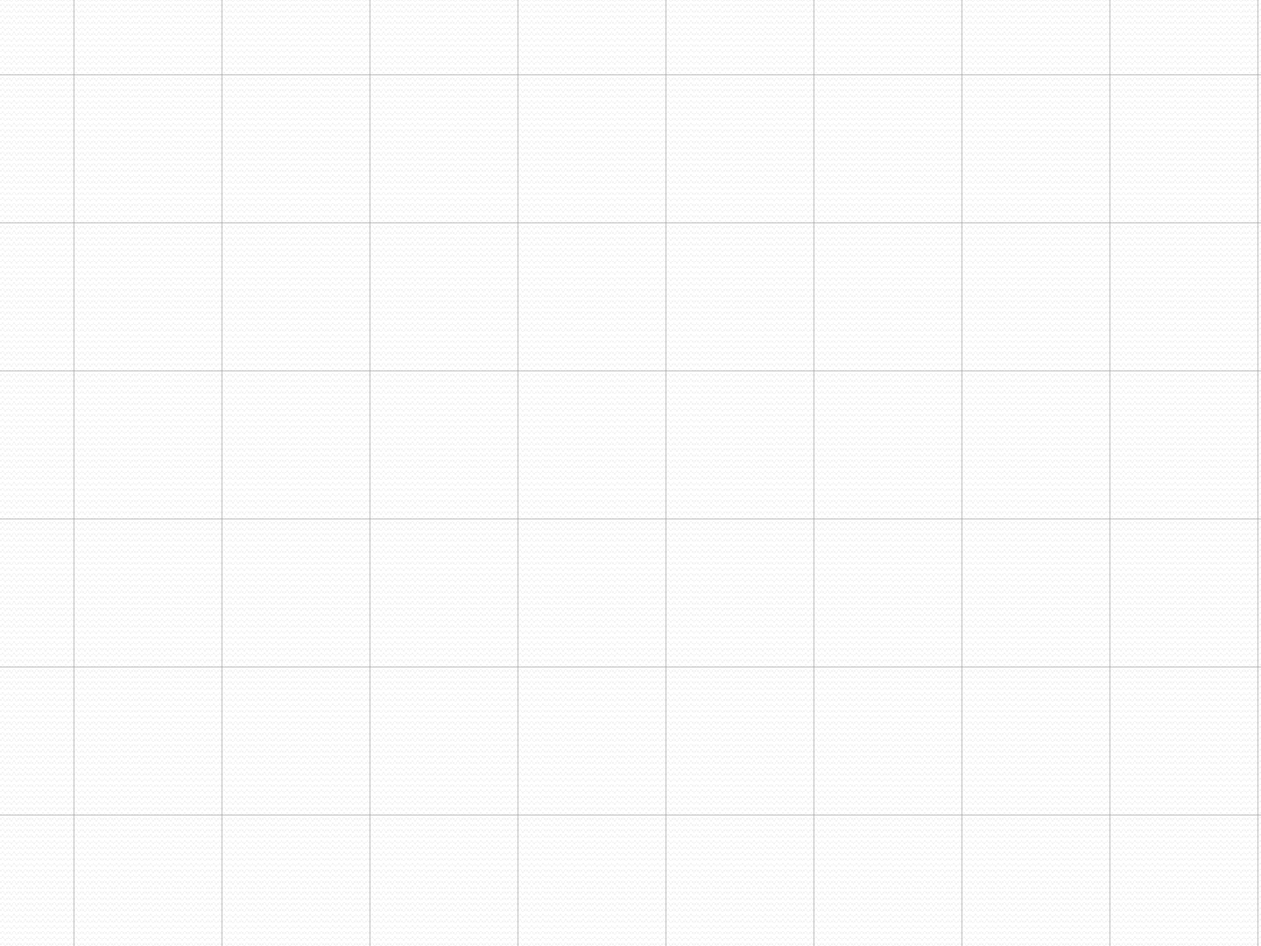

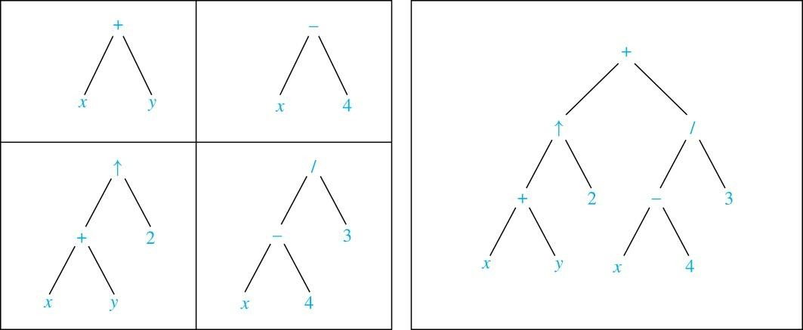
Expression Trees
Complex expressions can be represented using ordered
rooted trees.
Consider the expression ((x + y) + 2 ) + ((x − 4)/3).
A binary tree for the expression can be built from the
bottom up, as is illustrated here.

Slide 30
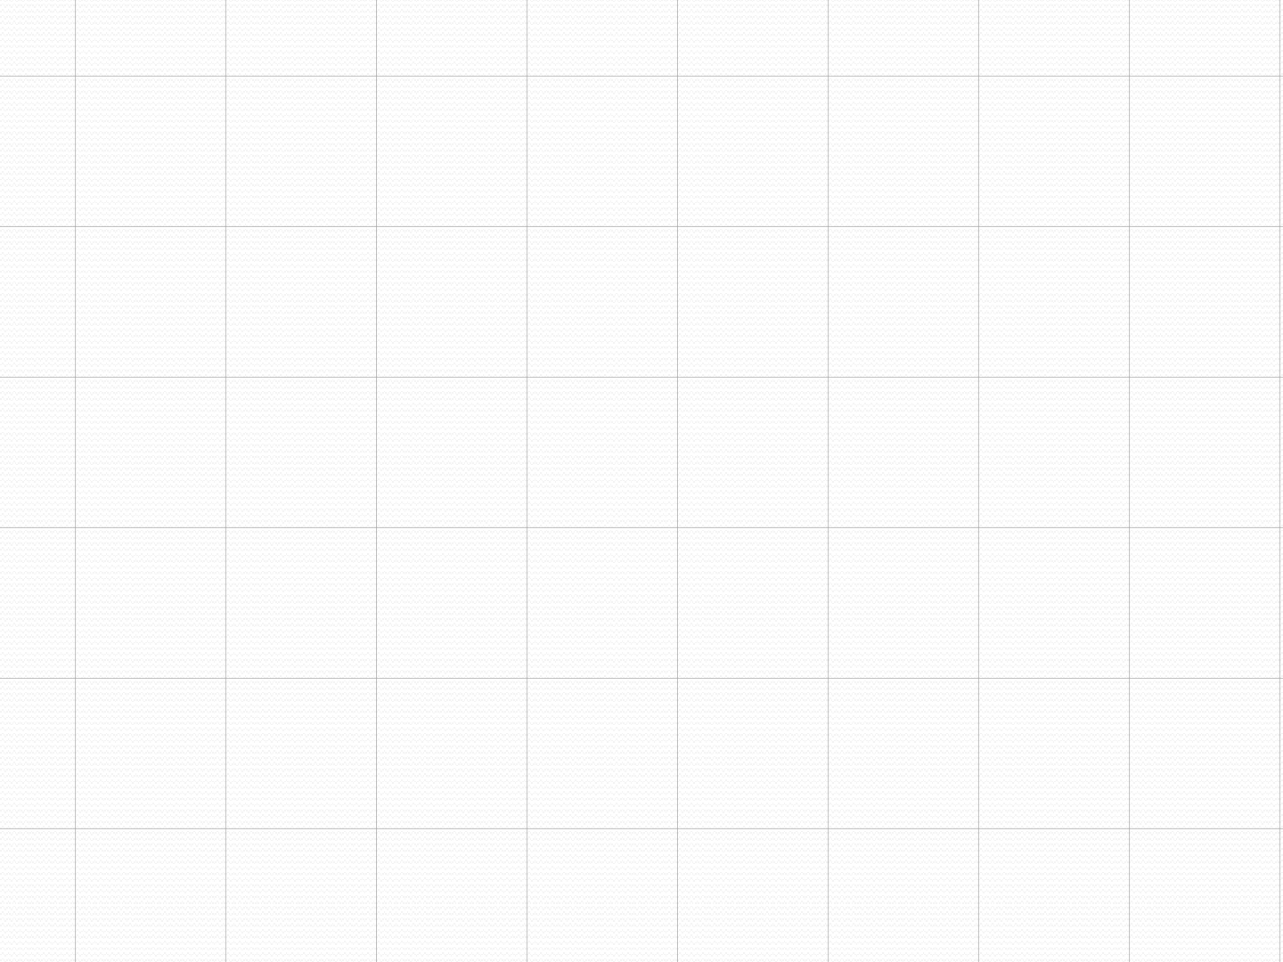
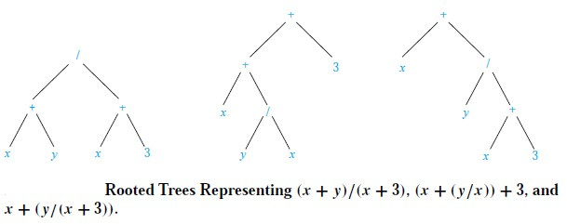
Infix Notation
An inorder traversal of the tree representing an expression produces the original expression when parentheses are included except for unary operations, which now immediately follow their operands.
We illustrate why parentheses are needed with an example that displays three trees all yield the same infix representation.

Slide 31


Prefix Notation
Jan Łukasiewicz (1878-1956)
When we traverse the rooted tree representation of an expression in preorder, we obtain the prefix form of the expression. Expressions in prefix form are said to be in Polish notation, named after the Polish logician Jan Łukasiewicz.
Operators precede their operands in the prefix form of an expression. Parentheses are not needed as the representation is unambiguous.
The prefix form of ((x + y) + 2 ) + ((x − 4)/3) is + 𝗍 + x y 2 / − x 4 3.
Prefix expressions are evaluated by working from right to left. When we encounter an operator, we perform the corresponding operation with the two operations to the right.

Slide 32


Prefix Notation
Example: We show the steps used to evaluate a particular prefix expression:

Slide 33

Postfix Notation
We obtain the postfix form of an expression by traversing its binary trees in postorder. Expressions written in postfix form are said to be in reverse Polish notation.
Parentheses are not needed as the postfix form is unambiguous.
x y + 2 𝗍 x 4 − 3 / + is the postfix form of ((x + y) 𝗍 2 ) + ((x
− 4)/3).
A binary operator follows its two operands. So, to evaluate an expression one works from left to right, carrying out an operation represented by an operator on its preceding operands.

Slide 34


Postfix Notation
Example: We show the steps used to evaluate a particular postfix expression.

Slide 35

Section 11.4

Slide 36

Section Summary
Spanning Trees
Prim’s Algorithm
Kruskal Algorithm

Slide 37


Spanning Trees
Definition: Let G be a simple graph. A spanning tree of G is a
subgraph of G that is a tree containing every vertex of G.
Example: Find the spanning tree of the simple graph:

Slide 38


Spanning Trees
Solution: The graph is connected, but is not a tree because it contains simple circuits. Remove the edge {a, e}. Now one simple circuit is gone, but the remaining subgraph still has a simple circuit. Remove the edge {e, f} and then the edge
{c, g} to produce a simple graph with no simple circuits. It is a spanning tree, because it contains every vertex of the original graph.

Slide 39

Section 11.5
https://drive.google.com/drive/folders/1a2PKSn-8gb8qC8AL437HEggrNmy5pvfV

Slide 40
MINIMUM SPANNING TREES
What are minimum spanning trees (MSTs)?

Slide 41
TREES IN GRAPHS
Let’s go over some terminology that we’ll be using today.
A tree is an undirected, acyclic, connected graph.
Which of these graphs are trees?

Slide 42
TREES IN GRAPHS
Let’s go over some terminology that we’ll be using today.
A tree is an undirected, acyclic, connected graph.
Which of these graphs are trees?
This single node is technically a valid tree!
Contains cycle
Contains cycle
Contains cycle

Slide 43
SPANNING TREES
A spanning tree is a tree that connects all of the vertices in the graph
Which of these are spanning trees?

Slide 44
SPANNING TREES
A spanning tree is a tree that connects all of the vertices
Which of these graphs are spanning trees?
Doesn’t connect all vertices
Not a tree
Not a tree
Not a tree
Doesn’t connect all vertices

Slide 45
MINIMUM SPANNING TREES (MSTs)
For the remainder of today, we’re going to work with undirected, weighted, connected graphs.
The cost of a spanning tree is the sum of the weights on the edges.
An MST of a graph is a spanning tree of the graph with minimum cost.
B
8
C
7
D
4
2
9
A
11
I
4
E
14
7
8
6
10
H
G
F
1
2

Slide 46
MINIMUM SPANNING TREES (MSTs)
For the remainder of today, we’re going to work with undirected, weighted, connected graphs.
The cost of a spanning tree is the sum of the weights on the edges.
An MST of a graph is a spanning tree of the graph with minimum cost.
B
8
C
7
D
Note: A graph may have multiple spanning trees. It may also have multiple MSTs (if 2 different spanning trees have the same exact cost)
4
2
9
A
11
I
4
E
14
7
8
6
10
H
G
F
1
2

Slide 47
MINIMUM SPANNING TREES (MSTs)
For the remainder of today, we’re going to work with undirected, weighted, connected graphs.
The cost of a spanning tree is the sum of the weights on the edges.
An MST of a graph is a spanning tree of the graph with minimum cost.
B
8
C
7
D
Note: A graph may have multiple spanning trees. It may also have multiple MSTs (if 2 different spanning trees have the same exact cost)
4
2
9
This spanning tree has a cost of 67.
A
11
I
4
E
14
7
8
6
10
H
G
F
1
2

Slide 48
MINIMUM SPANNING TREES (MSTs)
For the remainder of today, we’re going to work with undirected, weighted, connected graphs.
The cost of a spanning tree is the sum of the weights on the edges.
An MST of a graph is a spanning tree of the graph with minimum cost.
B
8
C
7
D
Note: A graph may have multiple spanning trees. It may also have multiple MSTs (if 2 different spanning trees have the same exact cost)
4
2
9
This spanning tree has a cost of 37.
This is an MST of this graph, since there is no other spanning tree with smaller cost.
A
11
I
4
E
14
7
8
6
10
H
G
F
1
2

Slide 49
MINIMUM SPANNING TREES (MSTs)
The task for today:
Given an undirected, weighted, and connected graph G,
find the minimum spanning tree (as a subset of the G’s edges)
B
8
C
7
D
4
2
9
We would return this MST. Sometimes, there may be more than one MST as well, so return any MST of G.
A
11
I
4
E
14
7
8
6
10
H
G
F
1
2

Slide 50
APPLICATIONS OF MSTs
Network design
Find the most cost-effective way to connect cities with roads/water/electricity/phone
Image processing
Image segmentation, which finds connected regions in the image with minimal differences
Cluster analysis
Find clusters in a dataset (one of the algorithms we’ll see today can be modified slightly to basically do this)
Useful primitive
Finding an MST is often useful as a subroutine or approximation for more advanced graph algorithms

Slide 51
MINIMUM SPANNING TREES (MSTs)
Before we move on with the lecture… why don’t you give this a try?
Brainstorm some greedy algorithms to find an MST!
B
8
C
7
D
4
2
9
11
4
A
I
14
E
7
8
6
10
H
G
F
1
2

Slide 52
PRIM’S ALGORITHM: THE IDEA
Greedy choice: Grow a single tree, & greedily add the shortest edge that could grow our tree
B
8
C
7
D
4
2
9
11
4
A
I
14
E
7
8
6
10
H
G
F
1
2

Slide 53
PRIM’S ALGORITHM: THE IDEA
Greedy choice: Grow a single tree, & greedily add the shortest edge that could grow our tree
B
8
C
7
D
4
2
9
11
4
First, we can initialize our tree to contain a single arbitrary node in G (doesn’t matter which node)
A
I
14
E
7
8
6
10
H
G
F
1
2

Slide 54
PRIM’S ALGORITHM: THE IDEA
Greedy choice: Grow a single tree, & greedily add the shortest edge that could grow our tree
B
8
C
7
D
4
2
9
11
4
Consider the edges coming out of the “frontier” of our growing tree.
A
I
14
E
7
8
6
10
H
G
F
1
2

Slide 55
PRIM’S ALGORITHM: THE IDEA
Greedy choice: Grow a single tree, & greedily add the shortest edge that could grow our tree
B
8
C
7
D
4
2
9
11
4
Claim the edge coming out of the “frontier” with the smallest weight
A
I
14
E
7
8
6
10
H
G
F
1
2

Slide 56
PRIM’S ALGORITHM: THE IDEA
Greedy choice: Grow a single tree, & greedily add the shortest edge that could grow our tree
B
8
C
7
D
4
2
9
11
4
Our tree just grew by one! Now repeat until we reach all the nodes.
A
I
14
E
7
8
6
10
H
G
F
1
2

Slide 57
PRIM’S ALGORITHM: THE IDEA
Greedy choice: Grow a single tree, & greedily add the shortest edge that could grow our tree
B
8
C
7
D
4
2
9
11
4
Consider the edges coming out of the “frontier” of our growing tree.
A
I
14
E
7
8
6
10
H
G
F
1
2

Slide 58
PRIM’S ALGORITHM: THE IDEA
Greedy choice: Grow a single tree, & greedily add the shortest edge that could grow our tree
B
8
C
7
D
4
2
9
11
4
Claim the edge coming out of the “frontier” with the smallest weight
(if there’s a tie, choose any)
A
I
14
E
7
8
6
10
H
G
F
1
2

Slide 59
PRIM’S ALGORITHM: THE IDEA
Greedy choice: Grow a single tree, & greedily add the shortest edge that could grow our tree
B
8
C
7
D
4
2
9
11
4
Consider the edges coming out of the “frontier” of our growing tree.
A
I
14
E
7
8
6
10
H
G
F
1
2

Slide 60
PRIM’S ALGORITHM: THE IDEA
Greedy choice: Grow a single tree, & greedily add the shortest edge that could grow our tree
B
8
C
7
D
4
2
9
11
4
Claim the edge coming out of the “frontier” with the smallest weight
A
I
14
E
7
8
6
10
H
G
F
1
2

Slide 61
PRIM’S ALGORITHM: THE IDEA
Greedy choice: Grow a single tree, & greedily add the shortest edge that could grow our tree
B
8
C
7
D
4
2
9
11
4
Consider the edges coming out of the “frontier” of our growing tree.
A
I
14
E
7
8
6
10
H
G
F
1
2

Slide 62
PRIM’S ALGORITHM: THE IDEA
Greedy choice: Grow a single tree, & greedily add the shortest edge that could grow our tree
B
8
C
7
D
4
2
9
11
4
Claim the edge coming out of the “frontier” with the smallest weight
A
I
14
E
7
8
6
10
H
G
F
1
2

Slide 63
PRIM’S ALGORITHM: THE IDEA
Greedy choice: Grow a single tree, & greedily add the shortest edge that could grow our tree
B
8
C
7
D
4
2
9
11
4
Consider the edges coming out of the “frontier” of our growing tree.
A
I
14
E
7
8
6
10
H
G
F
1
2

Slide 64
PRIM’S ALGORITHM: THE IDEA
Greedy choice: Grow a single tree, & greedily add the shortest edge that could grow our tree
B
8
C
7
D
4
2
9
11
4
Claim the edge coming out of the “frontier” with the smallest weight
A
I
14
E
7
8
6
10
H
G
F
1
2

Slide 65
PRIM’S ALGORITHM: THE IDEA
Greedy choice: Grow a single tree, & greedily add the shortest edge that could grow our tree
B
8
C
7
D
4
2
9
11
4
Consider the edges coming out of the “frontier” of our growing tree.
A
I
14
E
7
8
6
10
H
G
F
1
2

Slide 66
PRIM’S ALGORITHM: THE IDEA
Greedy choice: Grow a single tree, & greedily add the shortest edge that could grow our tree
B
8
C
7
D
4
2
9
11
4
Claim the edge coming out of the “frontier” with the smallest weight
A
I
14
E
7
8
6
10
H
G
F
1
2

Slide 67
PRIM’S ALGORITHM: THE IDEA
Greedy choice: Grow a single tree, & greedily add the shortest edge that could grow our tree
B
8
C
7
D
4
2
9
11
4
Consider the edges coming out of the “frontier” of our growing tree.
A
I
14
E
7
8
6
10
H
G
F
1
2

Slide 68
PRIM’S ALGORITHM: THE IDEA
Greedy choice: Grow a single tree, & greedily add the shortest edge that could grow our tree
B
8
C
7
D
4
2
9
11
4
Claim the edge coming out of the “frontier” with the smallest weight
A
I
14
E
7
8
6
10
H
G
F
1
2

Slide 69
PRIM’S ALGORITHM: THE IDEA
Greedy choice: Grow a single tree, & greedily add the shortest edge that could grow our tree
B
8
C
7
D
4
2
9
11
4
Consider the edges coming out of the “frontier” of our growing tree.
A
I
14
E
7
8
6
10
H
G
F
1
2

Slide 70
PRIM’S ALGORITHM: THE IDEA
Greedy choice: Grow a single tree, & greedily add the shortest edge that could grow our tree
B
8
C
7
D
4
2
9
11
4
Claim the edge coming out of the “frontier” with the smallest weight
A
I
14
E
7
8
6
10
H
G
F
1
2

Slide 71
PRIM’S ALGORITHM: THE IDEA
Greedy choice: Grow a single tree, & greedily add the shortest edge that could grow our tree
B
8
C
7
D
4
2
9
11
4
And we’re done!
This is our MST.
(with weight 37)
A
I
14
E
7
8
6
10
H
G
F
1
2

Slide 72
KRUSKAL’S ALGORITHM
Greedily add the cheapest edge!

Slide 73
KRUSKAL’S ALGORITHM: THE IDEA
Greedy choice: Maintain a forest of trees, & greedily add the cheapest edge to combine trees
B
8
C
7
D
4
2
9
11
4
A
I
14
E
7
8
6
10
H
G
F
1
2

Slide 74
KRUSKAL’S ALGORITHM: THE IDEA
Greedy choice: Maintain a forest of trees, & greedily add the cheapest edge to combine trees
B
8
C
7
D
4
2
9
11
4
Every node on its own starts as an individual tree in this forest
A
I
14
E
7
8
6
10
H
G
F
1
2

Slide 75
KRUSKAL’S ALGORITHM: THE IDEA
Greedy choice: Maintain a forest of trees, & greedily add the cheapest edge to combine trees
B
8
C
7
D
4
2
9
11
4
Choose the cheapest edge that would combine two trees (i.e. that won’t cause a cycle)
A
I
14
E
7
8
6
10
H
G
F
1
2

Slide 76
KRUSKAL’S ALGORITHM: THE IDEA
Greedy choice: Maintain a forest of trees, & greedily add the cheapest edge to combine trees
B
8
C
7
D
If there’s a tie, choose one of the edges
4
2
9
11
4
Choose the cheapest edge that would combine two trees (i.e. that won’t cause a cycle)
A
I
14
E
7
8
6
10
H
G
F
1
2

Slide 77
KRUSKAL’S ALGORITHM: THE IDEA
Greedy choice: Maintain a forest of trees, & greedily add the cheapest edge to combine trees
B
8
C
7
D
4
2
9
11
4
Choose the cheapest edge that would combine two trees (i.e. that won’t cause a cycle)
A
I
14
E
7
8
6
10
H
G
F
1
2

Slide 78
KRUSKAL’S ALGORITHM: THE IDEA
Greedy choice: Maintain a forest of trees, & greedily add the cheapest edge to combine trees
B
8
C
7
D
If there’s a tie, choose one of the edges
4
2
9
11
4
Choose the cheapest edge that would combine two trees (i.e. that won’t cause a cycle)
A
I
14
E
7
8
6
10
H
G
F
1
2

Slide 79
KRUSKAL’S ALGORITHM: THE IDEA
Greedy choice: Maintain a forest of trees, & greedily add the cheapest edge to combine trees
B
8
C
7
D
4
2
9
11
4
Choose the cheapest edge that would combine two trees (i.e. that won’t cause a cycle)
A
I
14
E
7
8
6
10
H
G
F
1
2

Slide 80
KRUSKAL’S ALGORITHM: THE IDEA
Greedy choice: Maintain a forest of trees, & greedily add the cheapest edge to combine trees
B
8
C
7
D
4
2
9
11
4
Choose the cheapest edge that would combine two trees (i.e. that won’t cause a cycle)
A
I
14
E
7
8
6
10
H
G
F
1
2

Slide 81
KRUSKAL’S ALGORITHM: THE IDEA
Greedy choice: Maintain a forest of trees, & greedily add the cheapest edge to combine trees
B
8
C
7
D
4
2
9
11
4
Choose the cheapest edge that would combine two trees (i.e. that won’t cause a cycle)
A
I
14
E
7
8
6
10
H
G
F
1
2

Slide 82
KRUSKAL’S ALGORITHM: THE IDEA
Greedy choice: Maintain a forest of trees, & greedily add the cheapest edge to combine trees
B
8
C
7
D
4
2
9
11
4
Choose the cheapest edge that would combine two trees (i.e. that won’t cause a cycle)
A
I
14
E
7
8
6
10
H
G
F
1
2

Slide 83
KRUSKAL’S ALGORITHM: THE IDEA
Greedy choice: Maintain a forest of trees, & greedily add the cheapest edge to combine trees
B
8
C
7
D
4
2
9
11
4
We’re done! This is the MST.
A
I
14
E
7
8
6
10
H
G
F
1
2

Slide 84

Minimum spanning tree
A minimum spanning tree in a connected weighted graph is a spanning tree that has the smallest possible sum of weights of its edges.
Example: A communications
company plans to network connecting
build a its five
computer centers. Any pair of these centers can be linked with a leased telephone line. Which links should be made to ensure that there is a path between any two computer centers so that the total cost of the network is minimized?

Slide 85


Minimum spanning tree
Solution: We can model this problem using the weighted graph shown in Figure 1, where vertices represent computer centers, edges represent possible leased lines, and the weights on edges are the monthly lease rates of the lines represented by the edges. We can solve this problem by finding a spanning tree so that the sum of the weights of the edges of the tree is minimized. Such a spanning tree is called a minimum spanning tree.

Slide 86


PRIM’S ALGORITHM

Slide 87



Minimal spanning tree (MST)
Example: Use Prims algorithm to find a minimal spanning tree for the graph below. Indicate the order in which edges are added to form the tree.
Order of adding the edges:
{a , b}, {b , c}, {c , d}, {d , e}, {e , f }, {f , g}
MST COST = 23

Slide 88


KRUSKAL’S ALGORITHM

Slide 89



Minimal spanning tree (MST)
Example: Use Kruskal’s algorithm to find a minimal spanning tree for the graph below. Indicate the order in which edges are added to form the tree.
MST COST = 23

